Slide 1
Training GitHub

Slide 2
What is GitHub?
GitHub is a web-based platform for the dissemination of free and open-source software.
Install GitHub
Install newest version of GitHub Git and TortoiseGit:
Notes:
Version control helps developers track and manage changes to a software project’s code. As a software project grows, version control becomes essential.

Slide 3
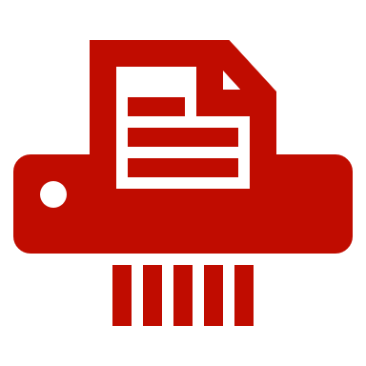





GitHub provides the following:
Version control for free and open-source software and other digital assets
Project discussion forums
DevOps to facilitate building and testing software
Bug reporting, patching, and tracking
Documentation hosting
An environment that fosters collaboration

Slide 4
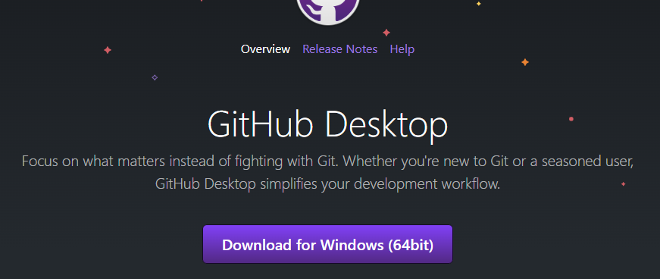
GitHub Desktop
Download from https://desktop.github.com/ and install it.

Slide 5
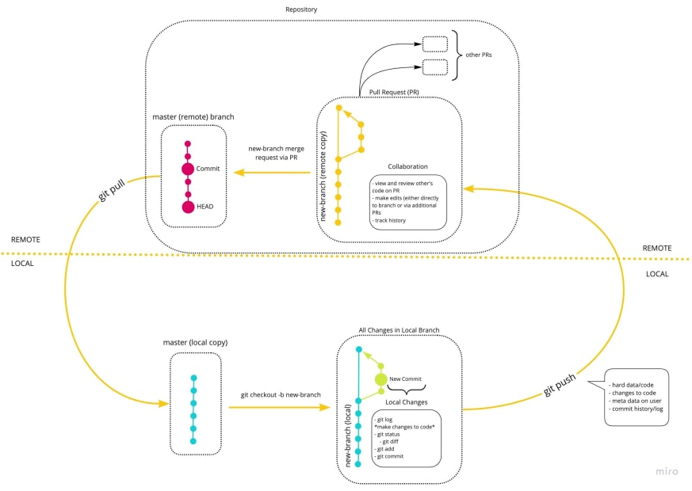
Git workflow

Slide 6
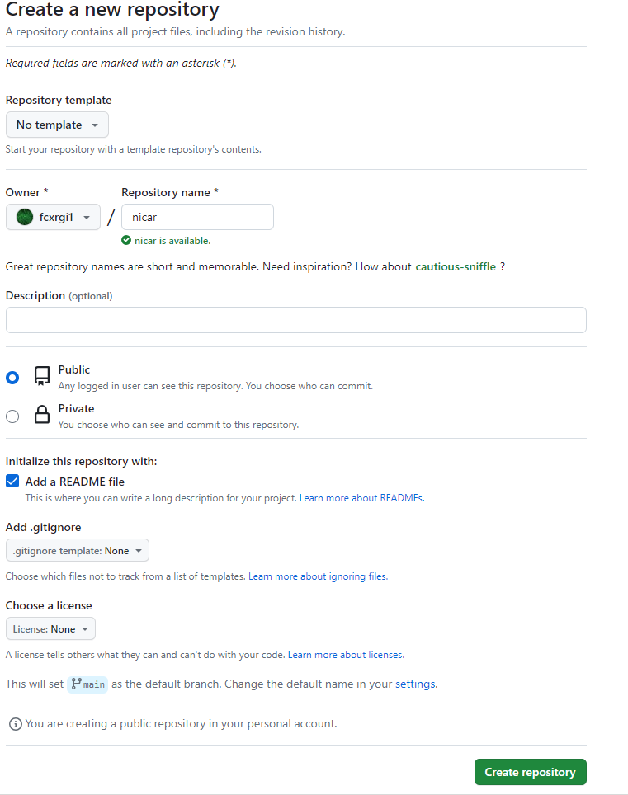
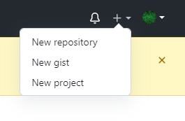
How to create a new repository
Log in to your GitHub account and navigate to the top right corner. Then, select 'New repository’

Slide 7
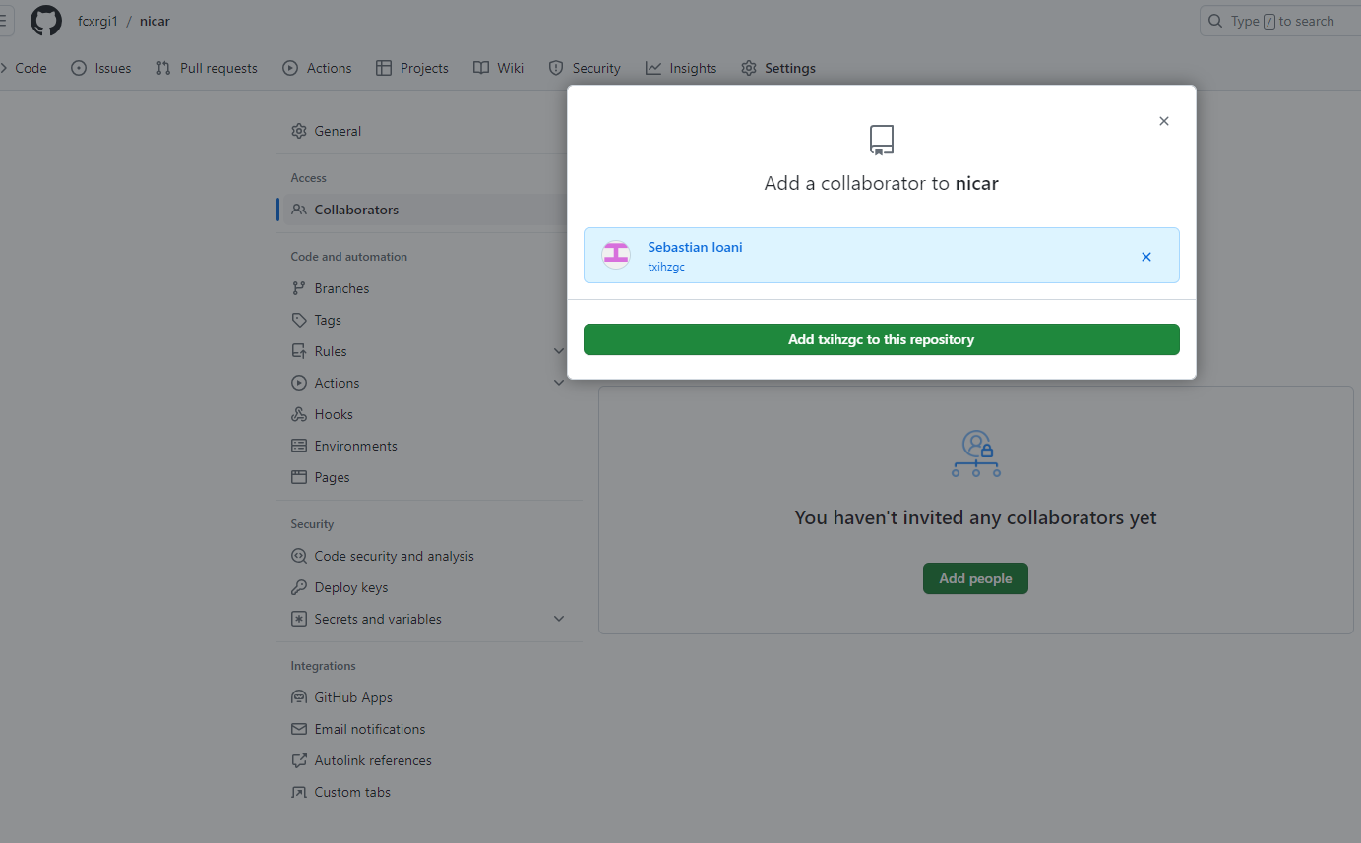
Add Collaborators
To collaborate with users in a repository that belongs to your personal account on GitHub, you can invite the users as collaborators
You can send an invitation to collaborate in your repository directly to someone on GitHub.

Slide 8
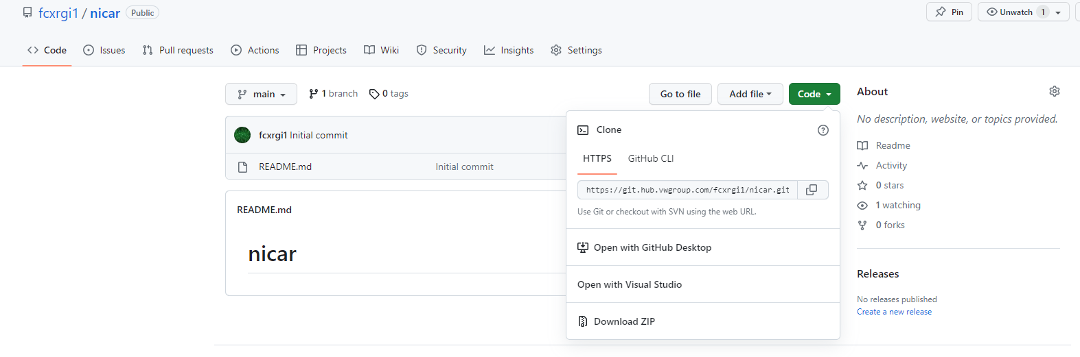
HTPPS of your git repository
The repository was created. In “Code” you can see the HTPPS of your git repository.

Slide 9
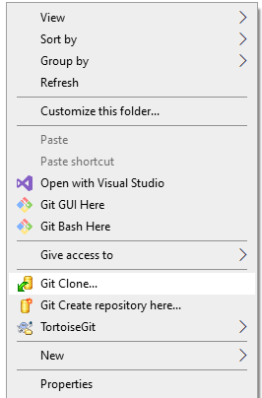
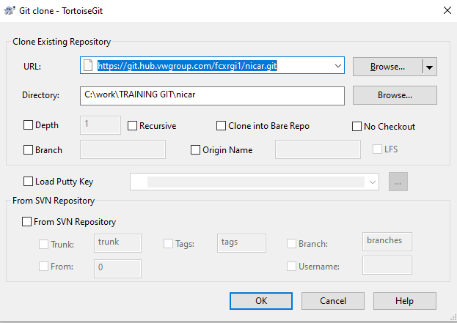
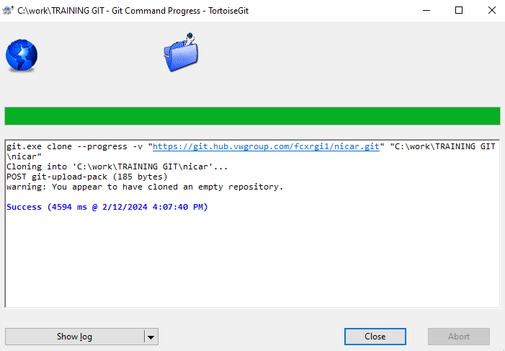
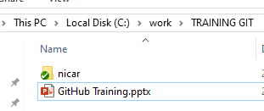
Clone repository from Tortoise
Go to the directory where you want to create the clone and right-click -> Git Clone…
In the UI, insert the URL link of your repository from Code->HTTPS
In the Directory field, you can set the name of the cloned folder.
A folder has been created at your location.
Inside, you can find a hidden folder named .git; this represents the connection between the git server and your local PC.

Slide 10
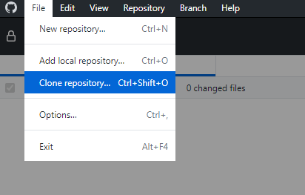
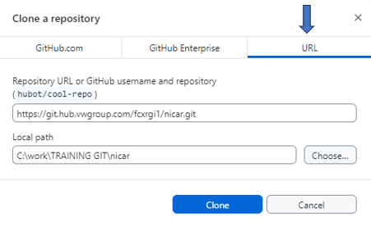
Clone repository from GitHub desktop
Click on File -> Clone repository.
Navigate to the URL tab and paste the HTTPS of your repository into the Repository URL field
In the local path, select the location for the clone, and then click on ‘Clone’.

Slide 11
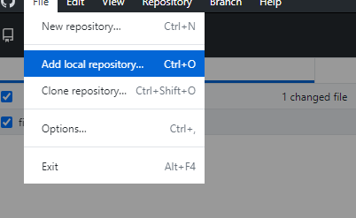
How to import the local repository in GitHub desktop
With GitHub Desktop, we can have a good overview of the project files
To import the cloned repository into GitHub Desktop: File -> Add Local repository -> Choose repository -> Add repository.

Slide 12
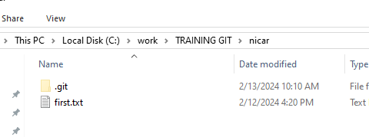
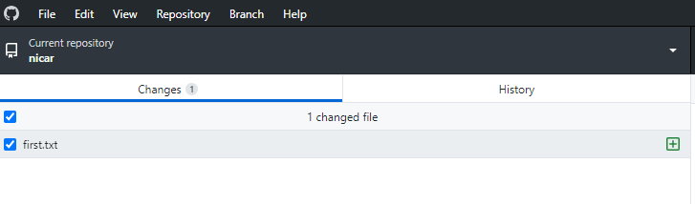
Create new file in local repository
Create a new file in local repository
In GitHub Desktop, you can see the modifications; a new file has been added to the local repository

Slide 13
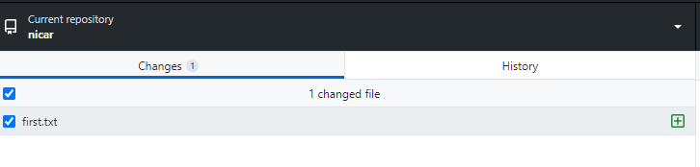
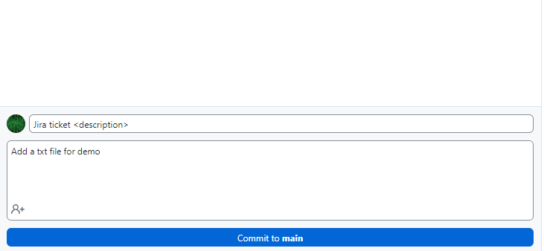
Create first commit
Creates a commit, which is like a snapshot of your repository. These commits are snapshots of your entire repository at specific times. You should make new commits often, based around logical units of change. Over time, commits should tell a story of the history of your repository and how it came to be the way that it currently is.
For every commit is necessary to add a title (Jira ID) and a description and press ‘Commit to main’.

Slide 14
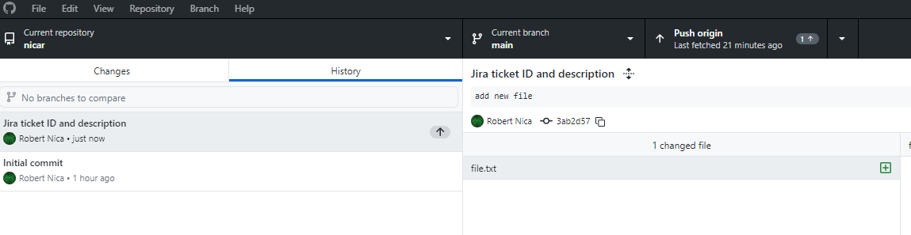
Push the commit on remote repository
Navigate to the 'History' tab where you can view the commit. However, the file doesn’t exist in the repository on the server because the commit is created only on your local PC. To see the file in the remote repository, it's necessary to perform a 'Push’.
The Git Push command is used to upload the content of a local repository to a remote repository. Pushing is the process of transferring commits from your local repository to a remote repository.

Slide 15
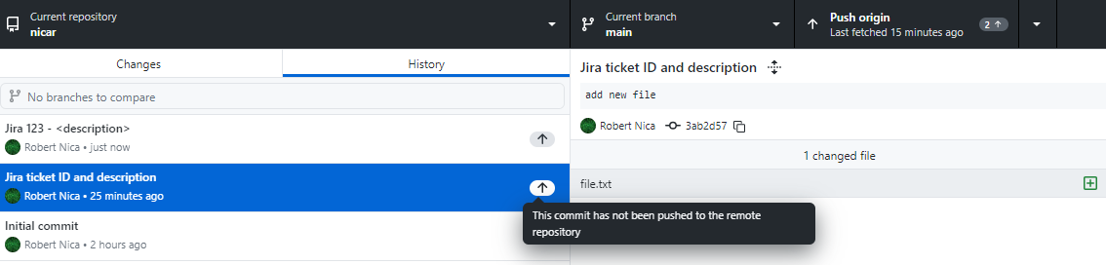
Push more commits
It's not necessary to push after every commit. You can create multiple commits and then push all of them to the remote repository at once.

Slide 16
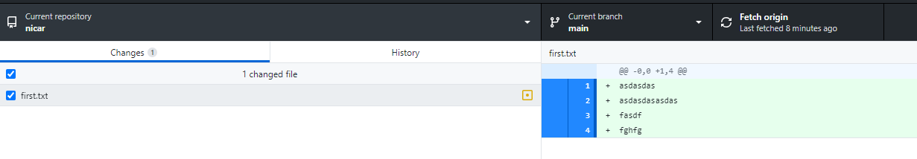
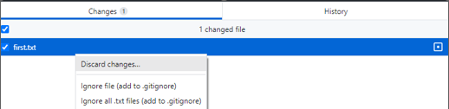
Modify a file in local repository
If you modify any file in the local repository, GitHub Desktop automatically refreshes, allowing you to see the differences between the local and remote repositories.
If you want to update the remote repository with a file, you need to create a new commit containing the changes and then push the commit to the remote repository.
To revert the changes for a file and discard them from the remote repository, you should right-click on the file and select 'Discard changes'

Slide 17
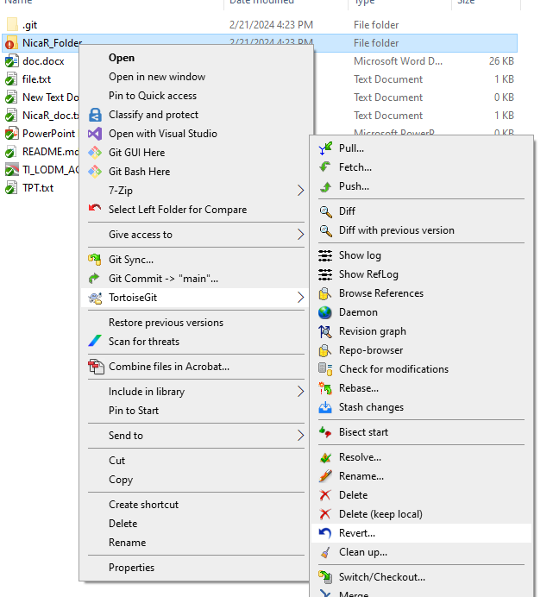
Discard all files from a folder
In TortoiseGit, you can revert changes by selecting a folder, right-clicking, and choosing 'Revert'. This command can be used for a single file or for an entire folder, reverting all files within it. All files in the folder will be overwritten with the latest version from the branch in the remote repository.

Slide 18
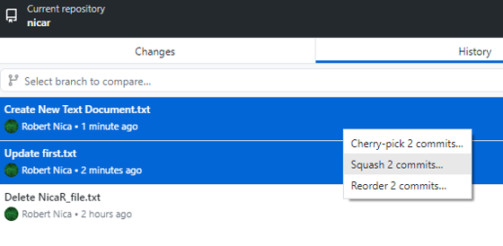
Squash commits
When working on a project and implementing a new feature, it's common to commit your code multiple times to test different aspects. This allows you to assess how the code functions or appears in various stages of development.
While doing this, the development process might become messy as you accumulate multiple commits, including ones for changes that may not be essential.
Because of this, you might want to combine all those commits into a single commit, a process known as commit squashing. It's important to note that you should squash commits only for your branch, not for the main branch
Warning ! To squash a commit that has already been pushed to the remote repository, you'll need to perform a force push to overwrite the commit history in the remote repository. However, it's important to note that for protected branches, a force push cannot be executed.

Slide 19
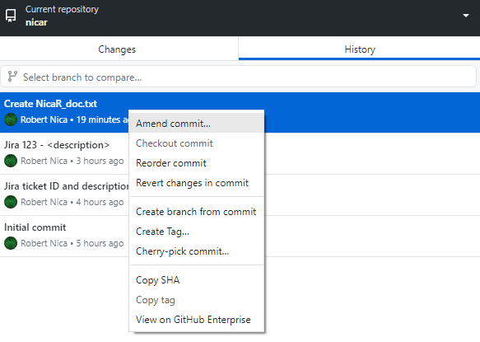
Amending a commit
Amending a commit is a way to modify the most recent commit you have made in your current branch. This can be helpful if you need to edit the commit message or if you forgot to include changes in the commit. When you amend a commit, you replace the previous commit with a new commit to your current branch.
If possible, you should only amend a commit that you haven't pushed to the remote repository. To amend a commit that has been pushed to the remote repository, you will need to use a force push to overwrite the commit history in the remote repository. Overwriting commit history may cause confusion for other collaborators working with the repository, because they may have already based work on the commit you have amended.
Warning ! It is recommended only for your branch, not for main !

Slide 20
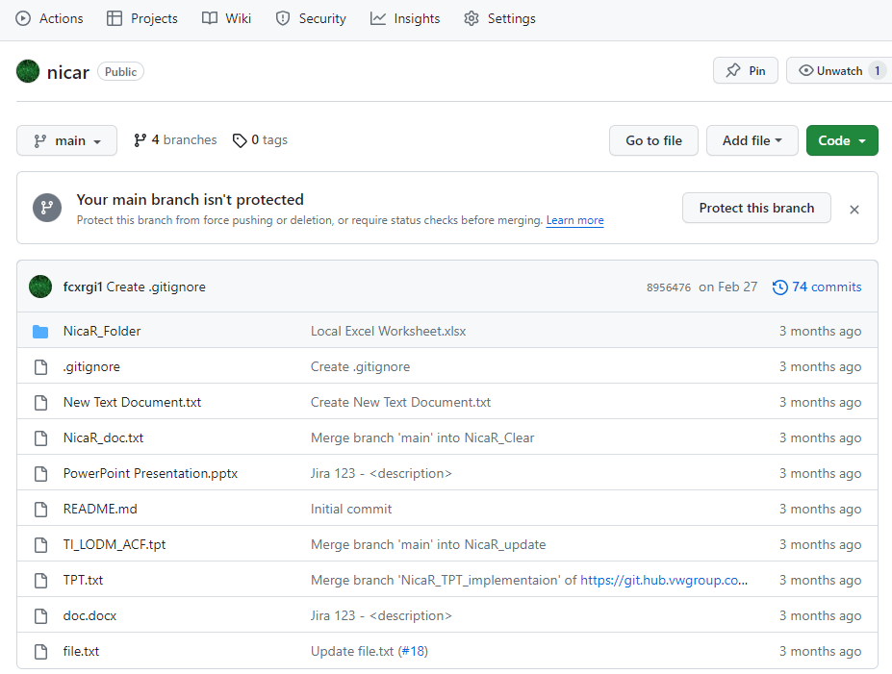
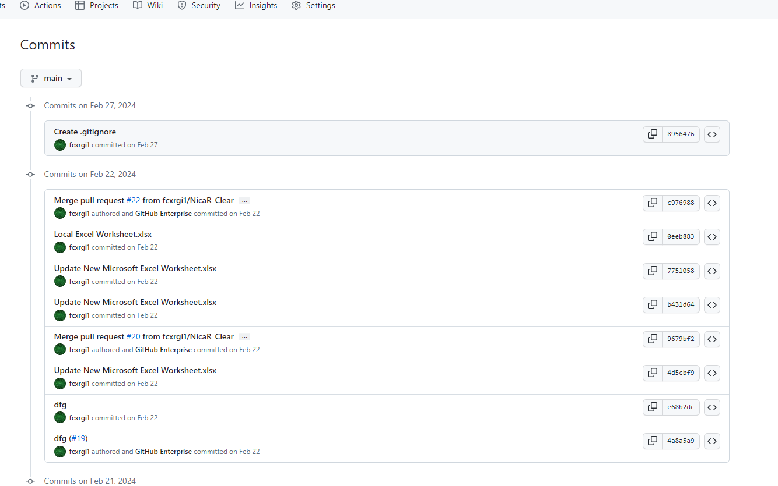
History commit on GitHub web
Navigate on web GitHub repository and select ‘commits’

Slide 21
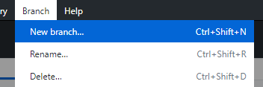
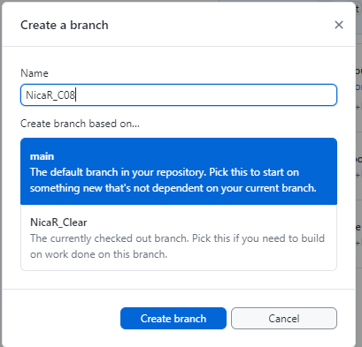
Create a new branch from GitHub desktop
GIT Branching is the strategy or systematic procedure of creating the branch and follow that up for merging that with the main copy of the main branch of the codebase
When starting work on a feature, it's necessary to create a new branch and work on it.
Warning ! Best practice: fetch before branch
Notes:
To create a new branch from the 'main' branch in GitHub Desktop, navigate to Branch -> New branch. Alternatively, if you want to create a branch from a specific commit, right-click on the commit -> Create branch from commit. Pushing the new branch to the server means you'll have a copy of the main branch or the specific commit as a new branch.

Slide 22
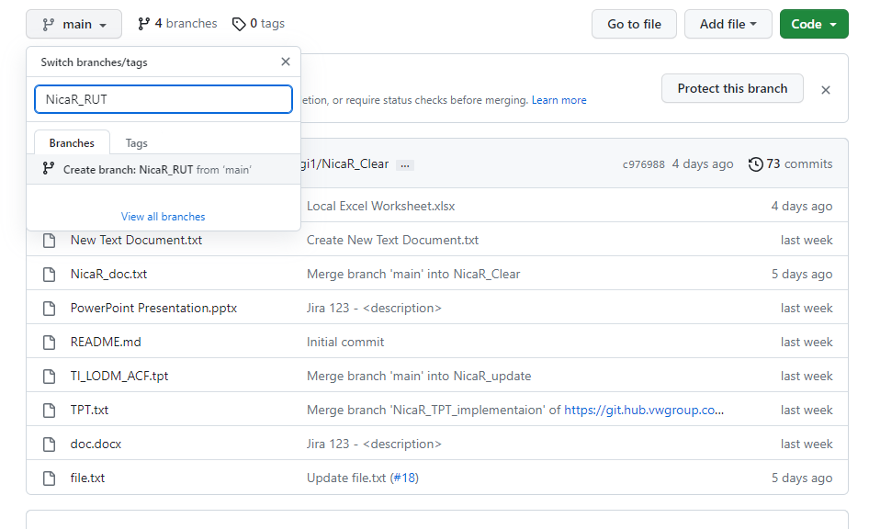
Create a new branch from GitHub web
To create a new branch in GitHub web, click on 'Switch branches', type the name of the new branch, and then click on 'Create branch’.

Slide 23
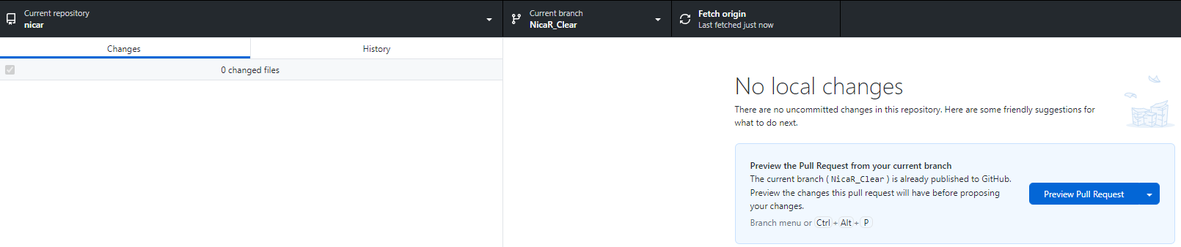
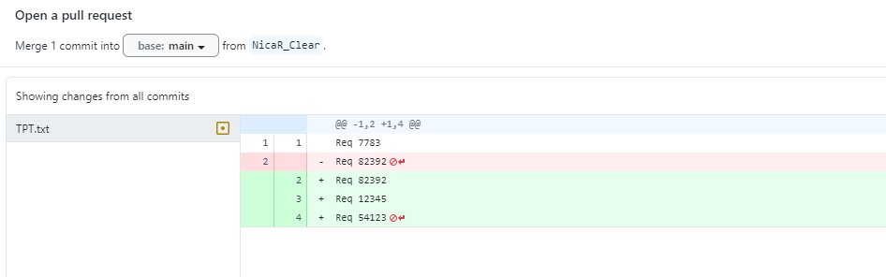

How to merge a branch without conflicts
After modifying and implementing a new feature in your branch, it is necessary to validate your work
To validate the work and incorporate all your changes into the main (or master) branch, it is necessary to create a 'pull request’.
In GitHub desktop select your branch and in ‘Changes’ tab you can select ‘Preview Pull Request’ and after preview you can press create Pull request.

Slide 24
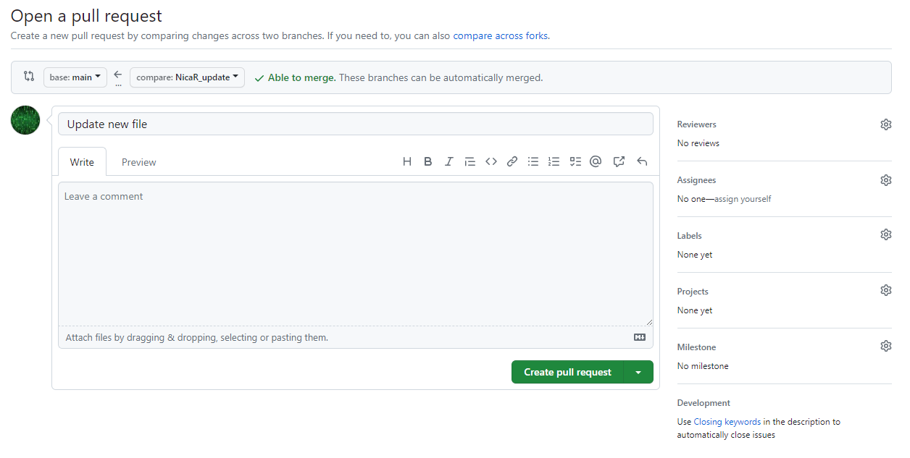
Open a pull request
On the right side, add reviewers for the merge.
For Assignees, select yourself.
Add a comment, then press 'Create pull request'.
After your pull request is approved, you can see all your modifications in the main branch.
If there are no conflicts, the check will be green, indicating 'Able to merge'.

Slide 25
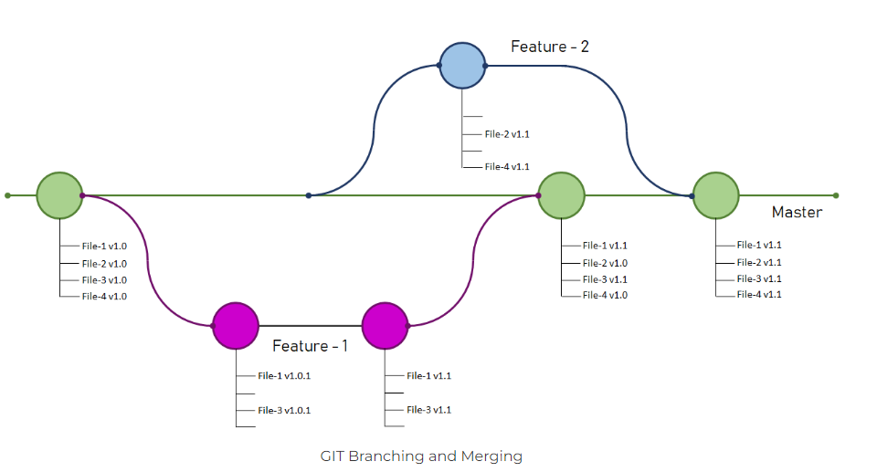
Git branch example

Slide 26
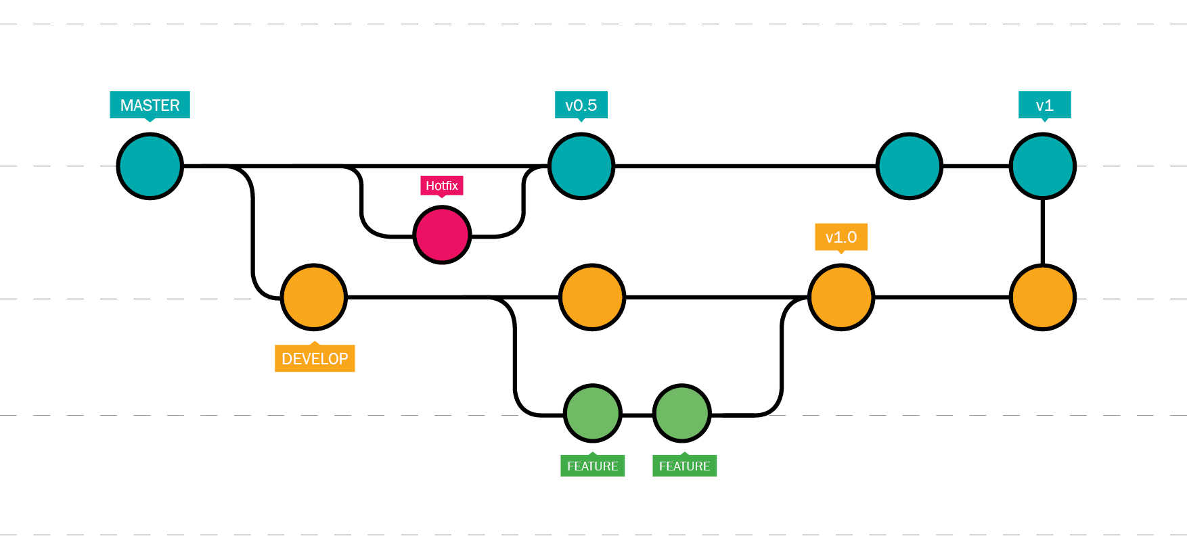
Git branch example

Slide 27
Difference between Fetch and Pull
What is Git Fetch?
Git Fetch command is used to fetch all changes from the remote repository to the local repository. It doesn’t make any changes to the current working directory. It stores all the changes in a separate branch called the remote-tracking branch. git merge or git rebase command is used to merge these changes into our current working directory.
What is Git Pull?
Git Pull command is used to fetch all changes from the remote repository to the current working directory. It automatically try to merge or rebase them into our current working directory. It is the combination of git fetch and git merge, or git rebase. It can generate merge conflicts if there are conflict changes between our local and remote branches.
Fetch vs Pull
Git Fetch command fetches all the changes from the remote repository to the local repository without bringing the changes into the working directory. Git Pull on the other hand brings the copy of the remote directory changes into the working directory. In this article, Let us look at Git Fetch and Git Pull separately with the help of an example.

Slide 28
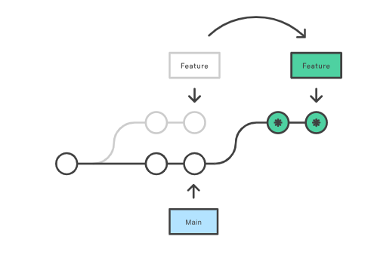
Git rebase
Rebasing is the process of moving or combining a sequence of commits to a new base commit. Rebasing is most useful and easily visualized in the context of a feature branching workflow. The general process can be visualized as the following:
From a content perspective, rebasing is changing the base of your branch from one commit to another making it appear as if you'd created your branch from a different commit. Internally, Git accomplishes this by creating new commits and applying them to the specified base. It's very important to understand that even though the branch looks the same, it's composed of entirely new commits.

Slide 29
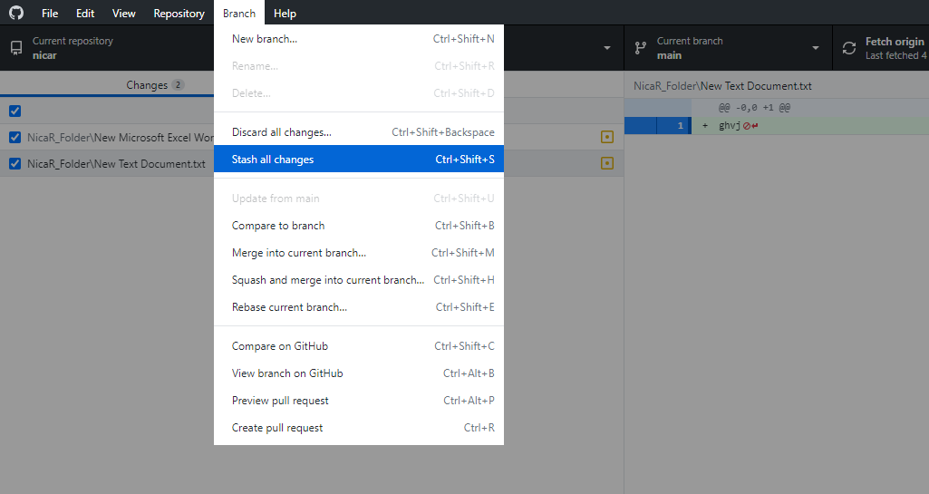
Git Stash
Use git stash when you want to record the current state of the working directory and the index but want to go back to a clean working directory. The command saves your local modifications away and reverts the working directory to match the HEAD commit.

Slide 30
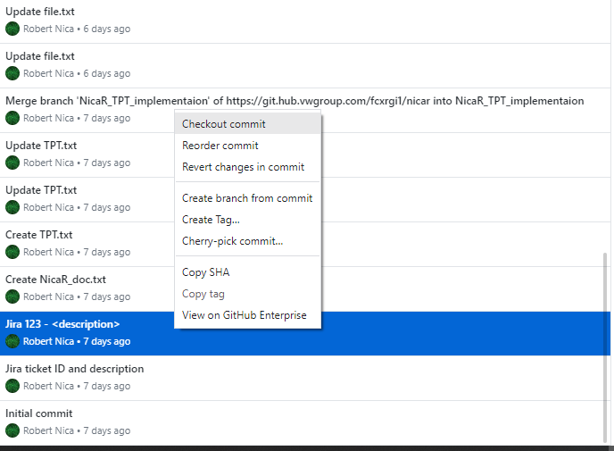
Checkout Remote Git Branches
Checking out a commit allows you to view your repository in a previous state without needing to create a new branch or modify an existing branch. This can be helpful when debugging since it allows you to see if a bug exists in your repository at a previous commit.
Checking out a commit puts your repository in a "detached HEAD" state. In Git terminology "HEAD" is the reference that points to the tip, or latest commit, of a named branch in your repository. A "detached HEAD" state means that HEAD refers to a specific commit, but not on a named branch in your repository.

Slide 31
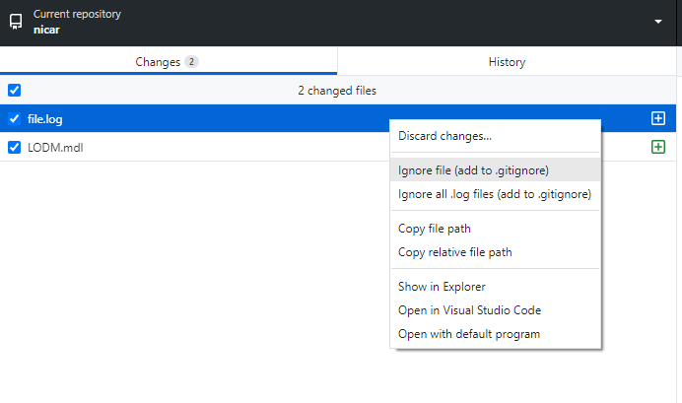
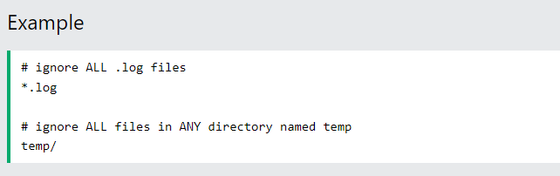
Git Ignore and .gitignore
When sharing your code with others, there are often files or parts of your project, you do not want to share. The .gitignore file is created automatically when you select 'Ignore file' from GitHub Desktop.
Git can specify which files or parts of your project should be ignored by Git using a .gitignore file.
Git will not track files and folders specified in .gitignore. However, the .gitignore file itself IS tracked by Git.
Rules for .gitignore
Notes:
Examples for files in git ignore
log files
temporary files
hidden files
personal files, etc.

Slide 32
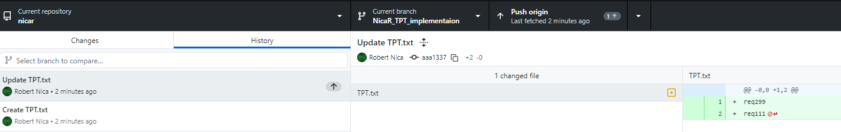
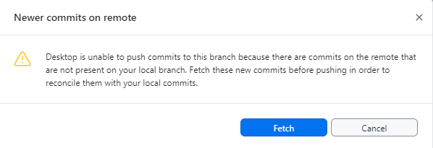
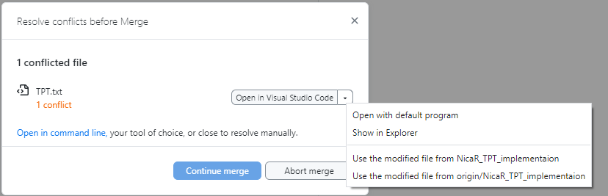
Push file conflict
If a file is edited in the online repository by another user, and I haven't received the latest changes on my PC, attempting to modify the same file at the same line will result in a conflict that needs to be resolved. When trying to push the changes, an error occurs: 'Newer commits on remote'. To resolve this, you should first press Fetch and then Pull to obtain the latest changes. After that, conflicts can be resolved manually by merging the files, or by using the modified file from a specific branch.

Slide 33
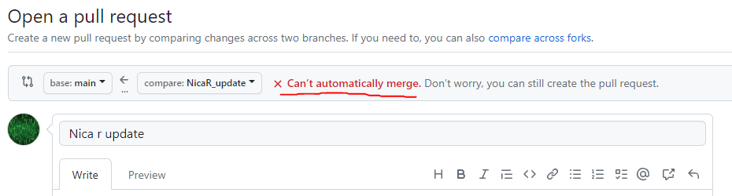
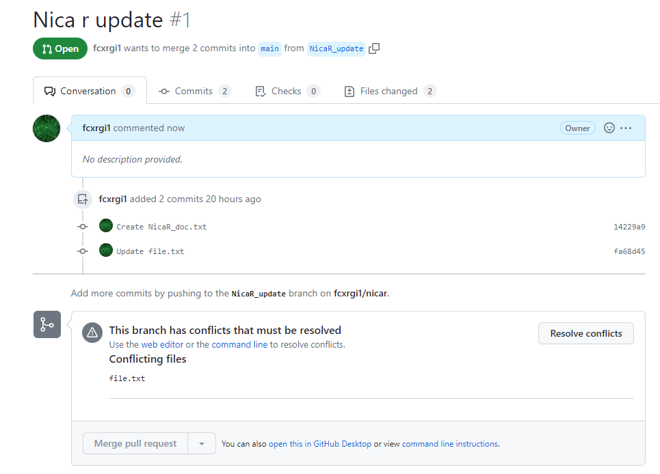
Open a pull request with file conflict
A file conflict was found for file.txt. To proceed with the merge, it is necessary to resolve these conflicts.

Slide 34
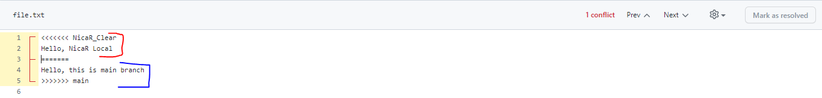
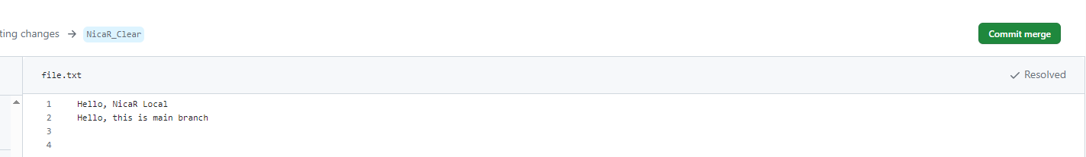
How to solve the conflict for Pull request
After pressing 'Resolve conflict', the file will be displayed, highlighting the areas of conflict. The content from your branch will be marked in red, while the content from the main repository will be marked in blue. It's up to the user to decide which context to keep.
After resolving the conflict and deciding on the preferred version, a new commit will be created for the merge.

Slide 35
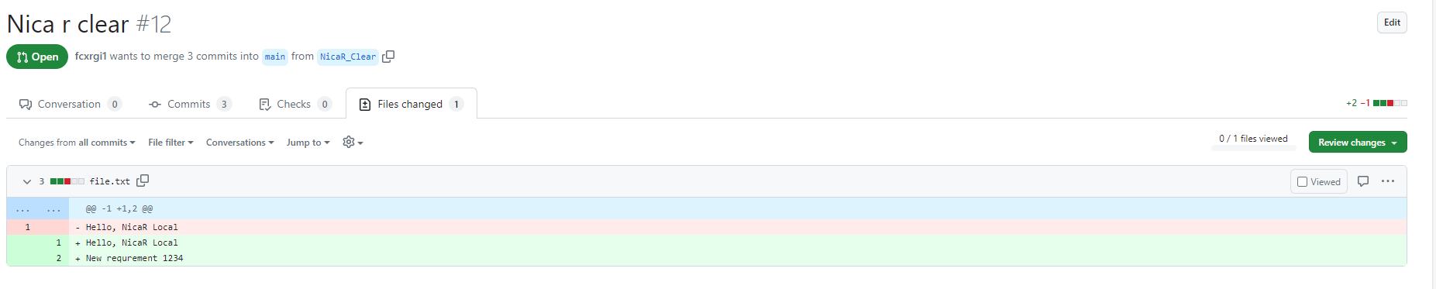
Files changed in pull request
If you go to the 'Files changed' tab, you can see the files that have been changed in your branch
On the right side, there is a 'Review changes' button where you can add comments.

Slide 36
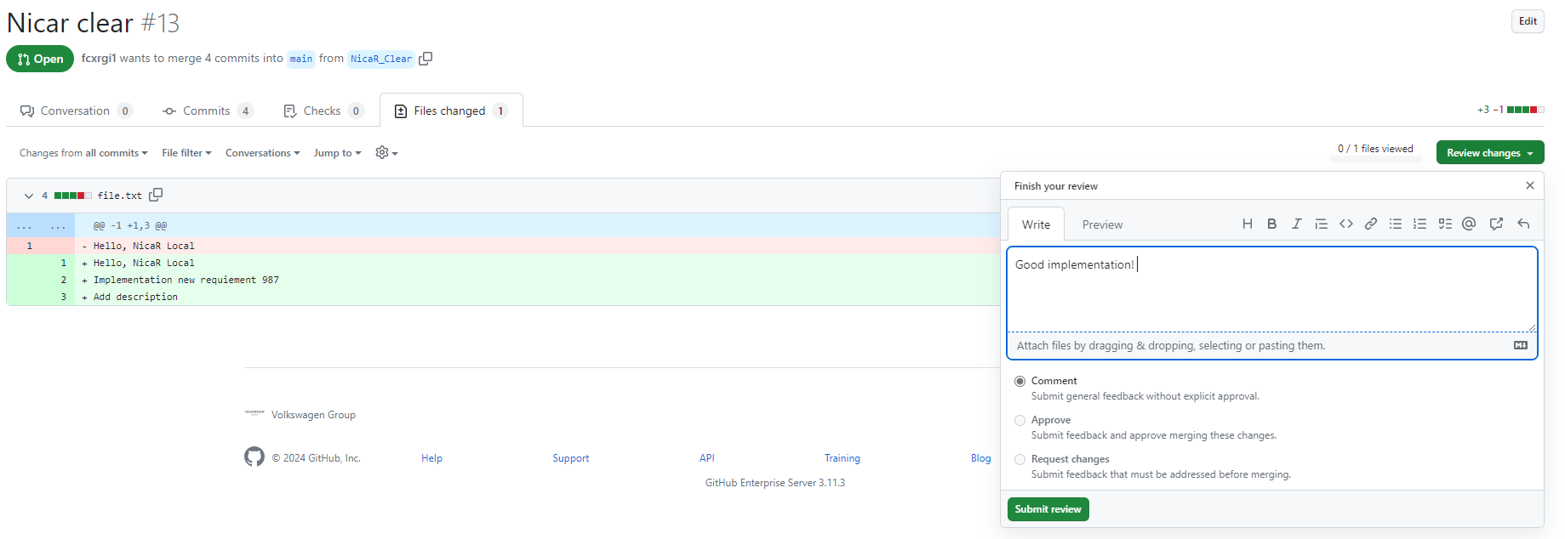
Review changes for files
You can add comments for the changes made to each file

Slide 37
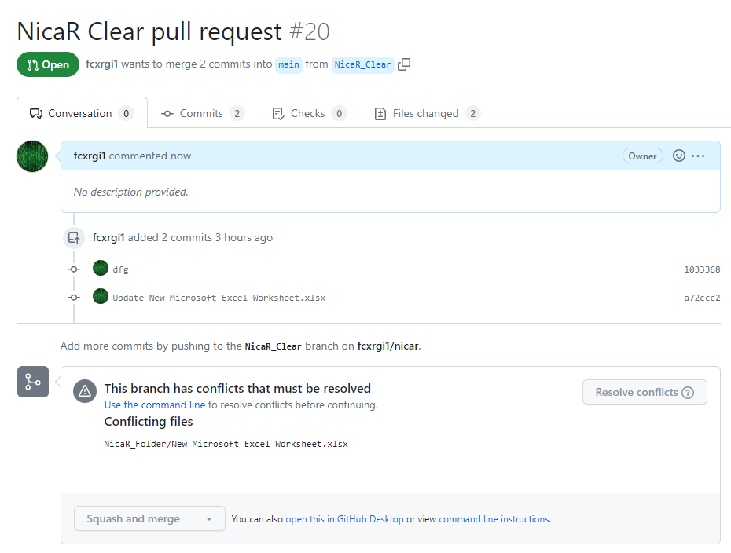
Pull request conflict for files non-text
In the case of a .xlsx file, resolving conflicts is not directly supported by Git because Git cannot open the file. This means that conflicts must be resolved locally on your PC.

Slide 38


Rebase your branch with main
To resolve the conflict, it is necessary to rebase the branch, which involves obtaining the differences between the main branch and your branch and merging them.
To resolve the conflict, it is necessary to rebase the branch, which involves obtaining the differences between the main branch and your branch and merging them.
Once the conflicts are resolved, you can proceed with the pull request and merge.

Slide 39

Merge pull request
After resolving the conflicts, you can proceed with the pull request, which offers three types of merges:
Create a merge commit: This option creates a new merge commit in the target branch, preserving the commit history of both branches
Squash and merge: This option condenses all the commits from the feature branch into a single commit before merging into the target branch.
Rebase and merge: This option rewrites the commit history of the feature branch onto the target branch, resulting in a linear commit history without additional merge commits.

Slide 40
About Git
https://docs.github.com/en/get-started/using-git/about-git
https://www.w3schools.com/git/git_remote_getstarted.asp?remote=github

Slide 41
Contact
Your contact person
Robert Nica Sebastian Ioani
SW Developer SW Developer
E-Mail: robert.nica@in-tech.com E-Mail: sebastian.ioani@in-tech.com
ProIT SRL
Calea Dumbravii 111A
550399 Sibiu
Romania
www.in-tech.com

